Slide 1
Value signals in the orbitofrontal cortex incorporate reference-dependent surprise utility
Brenden Eum*
Antonio Rangel
*slides

Slide 2

19XX
Christmas as a kid
Christmas 2022

Slide 3
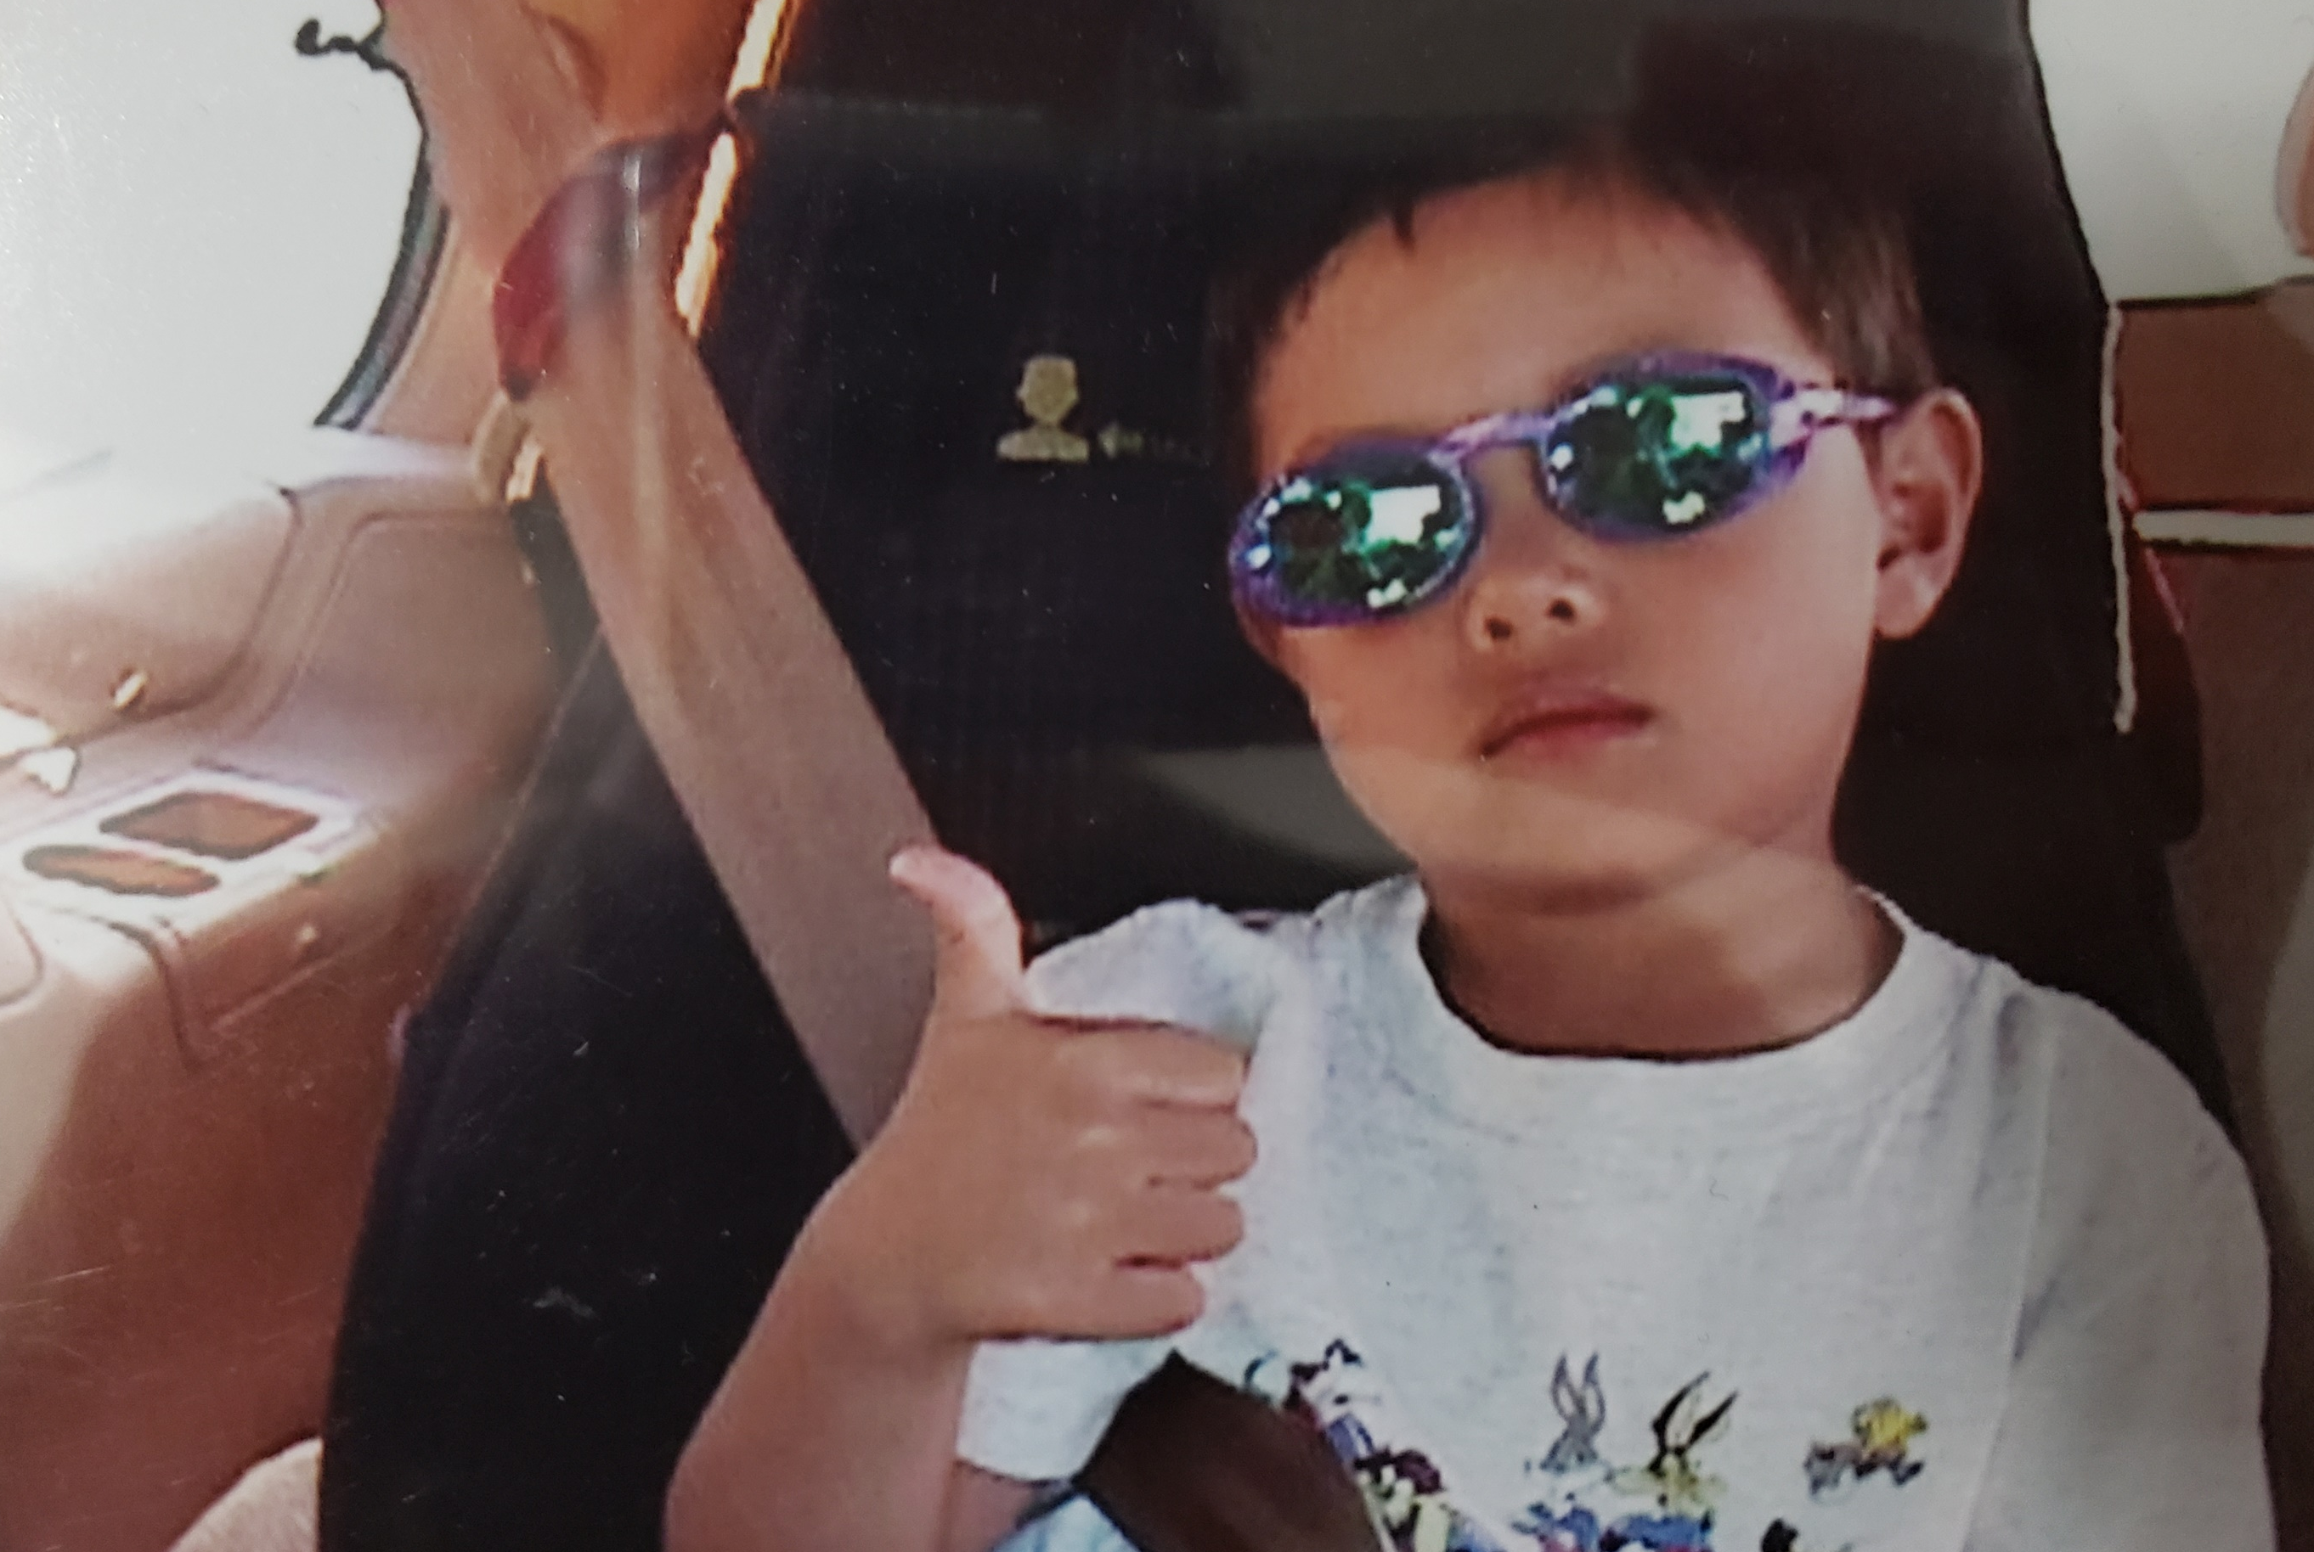
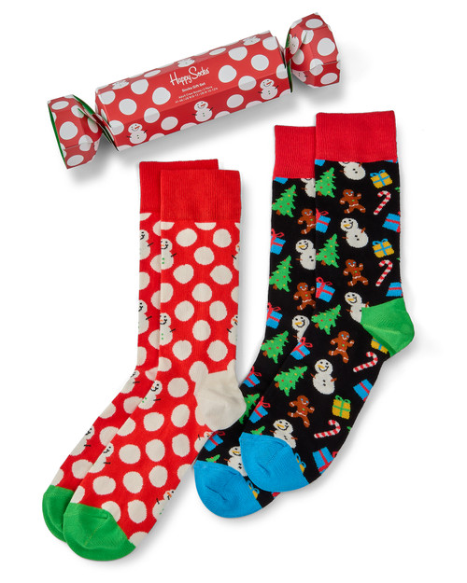
19XX
Christmas as a kid
Christmas 2022

Slide 4
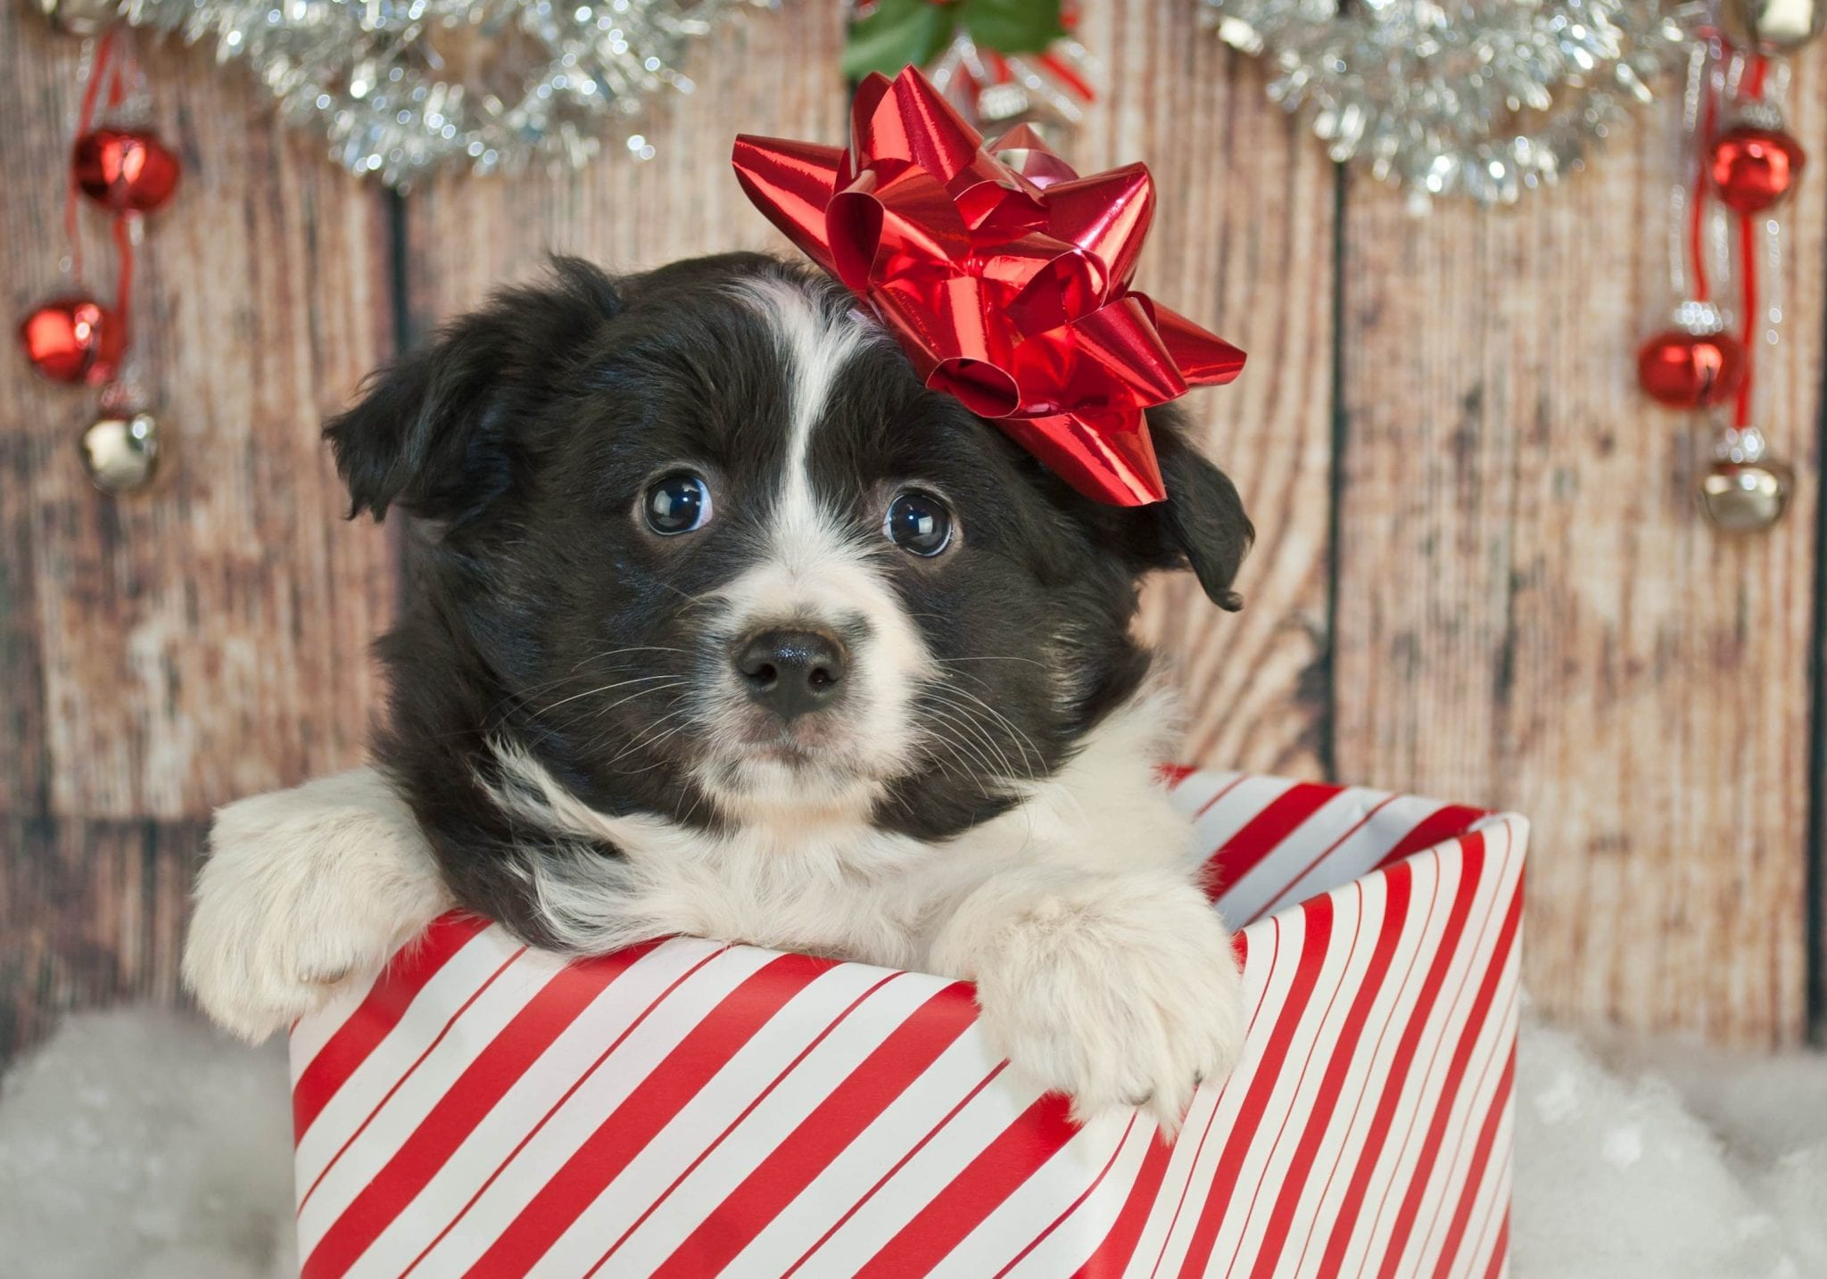
19XX
Christmas as a kid
Christmas 2022

Slide 5
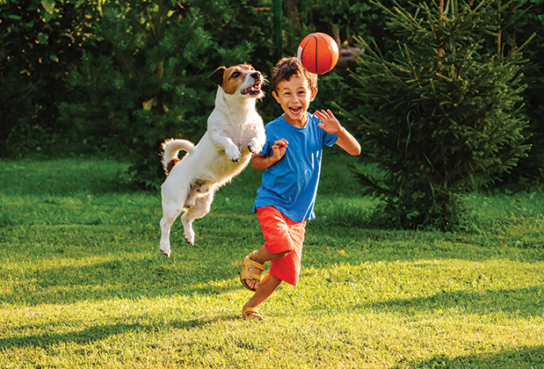
19XX
Christmas as a kid
Christmas 2022

Slide 6

Santa MIGHT’VE gotten you a puppy for Christmas
19XX
News of a puppy
Christmas as a kid
Christmas 2022

Slide 7
Santa MIGHT’VE gotten you a puppy for Christmas
19XX
News of a puppy
Christmas as a kid
Christmas 2022

Slide 8
Santa MIGHT’VE gotten you a puppy for Christmas
Do you experience positive utility when you receive good news?
19XX
News of a puppy
Christmas as a kid
Christmas 2022

Slide 9
Consumption Experienced Utility (cEU)
19XX
News of a puppy
Christmas as a kid
Christmas 2022

Slide 10
Surprise Experienced Utility (sEU)
Santa MIGHT’VE gotten you a puppy for Christmas
19XX
News of a puppy
Christmas as a kid
Christmas 2022

Slide 11
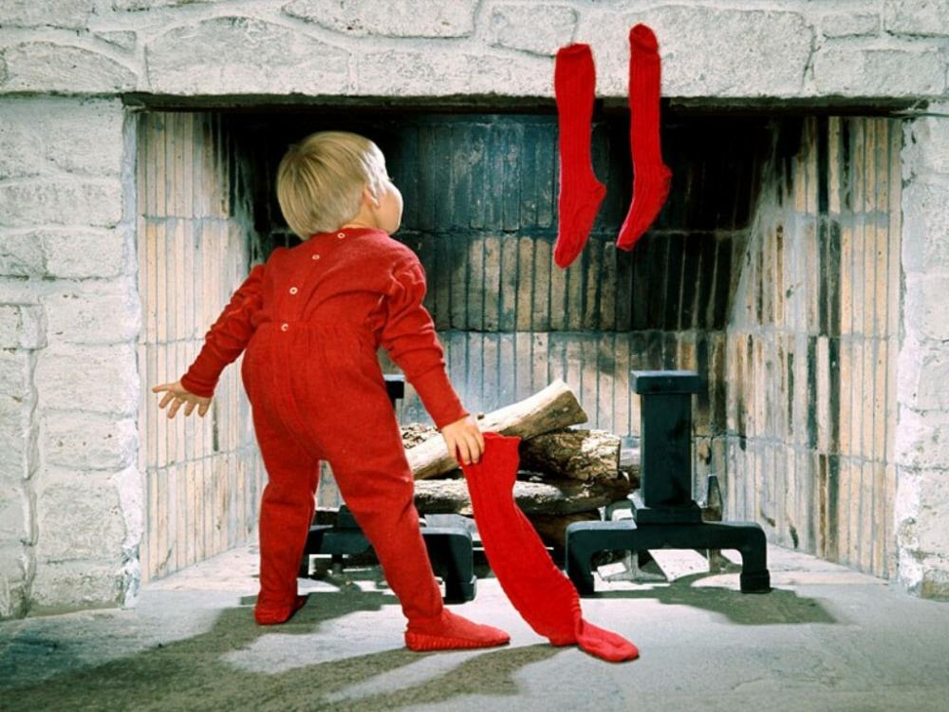
sEU is NOT anticipation
19XX
News of a puppy
Christmas as a kid
Christmas 2022

Slide 12
Is experienced utility only influenced by outcomes, or also by beliefs?

Slide 13
Behavioral economics
Disappointment aversion [Bell (1985), Loomes & Sugden (1986)]
Reference-dependent preferences [Koszegi & Rabin (2006, 2007, 2009)]

Slide 14
Behavioral economics
Disappointment aversion [Bell (1985), Loomes & Sugden (1986)]
Reference-dependent preferences [Koszegi & Rabin (2006, 2007, 2009)]
The assumption that experienced utility depends on both consumption and surprise has not been tested!

Slide 15
Neuroscience
Experienced utility signals are encoded in OFC [Plassmann et al. (2010), Kringelbach et al. (2003), Sescouse et al. (2013)]

Slide 16
Hypothesis: Value signals in the OFC incorporate reference-dependent surprise utility

Slide 17
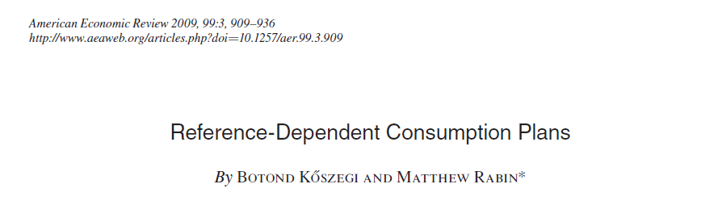

Slide 18
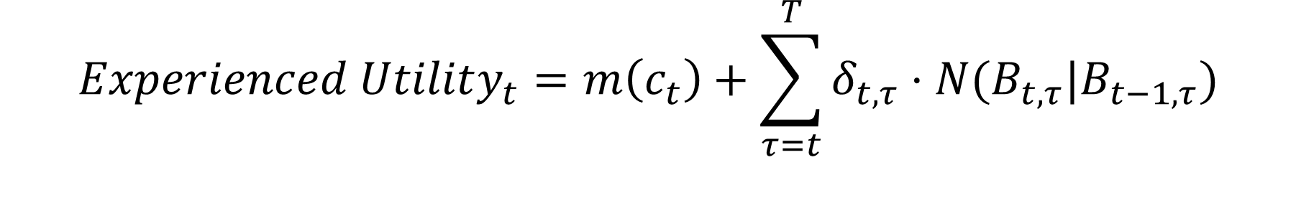
$$Experienced Utility_{t}=m\left(c_{t}\right)+\sum_{τ=t}^{T}{δ_{t,τ}⋅N(B_{t,τ}|B_{t−1, τ})}$$
cEU
discounting
present and future gain-loss utility function
beliefs inherited from time $t−1$ about consumption at time $τ$
Let N be some function of the difference in expected consumption
in the form of a “universal gain-loss utility function”:
Bowman, Minehart, and Rabin (1999)
Kahneman and Tversky (1979)

Slide 19
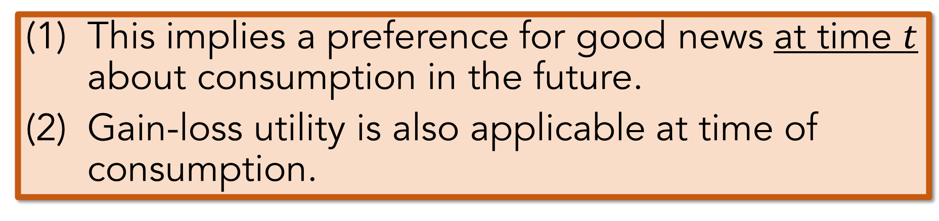
$$Experienced Utility_{t}=m\left(c_{t}\right)+\sum_{τ=t}^{T}{δ_{t,τ}⋅N(B_{t,τ}|B_{t−1, τ})}$$
cEU
sEU
This implies a preference for good news at time $t$ about consumption in the future.
Gain-loss utility is also applicable at time of consumption.

Slide 20
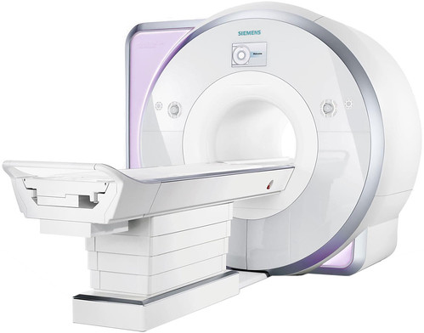

Viewing task
144 trials
2 blocks
Fractal choice task
24 trials
1 block
Rating task
72 trials
1 block
25 mins
2.5 mins
9 mins

Slide 21

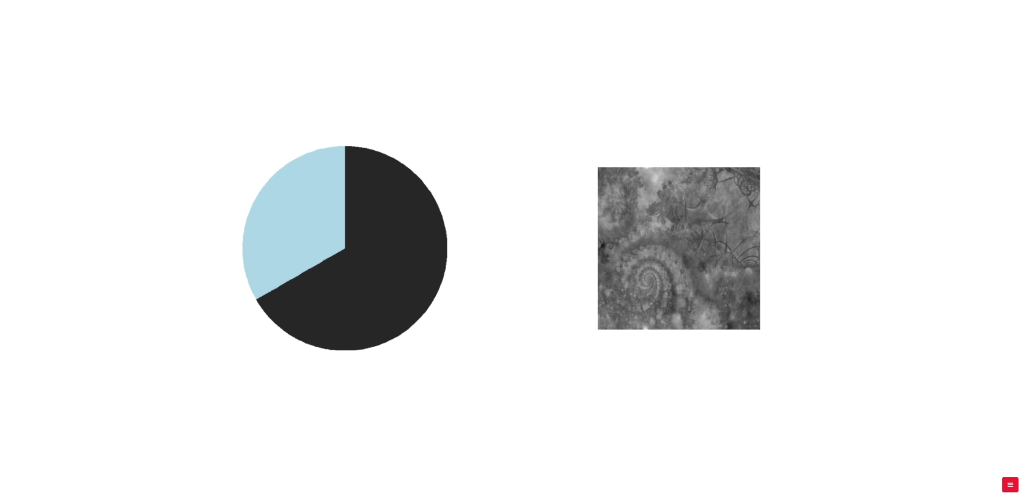

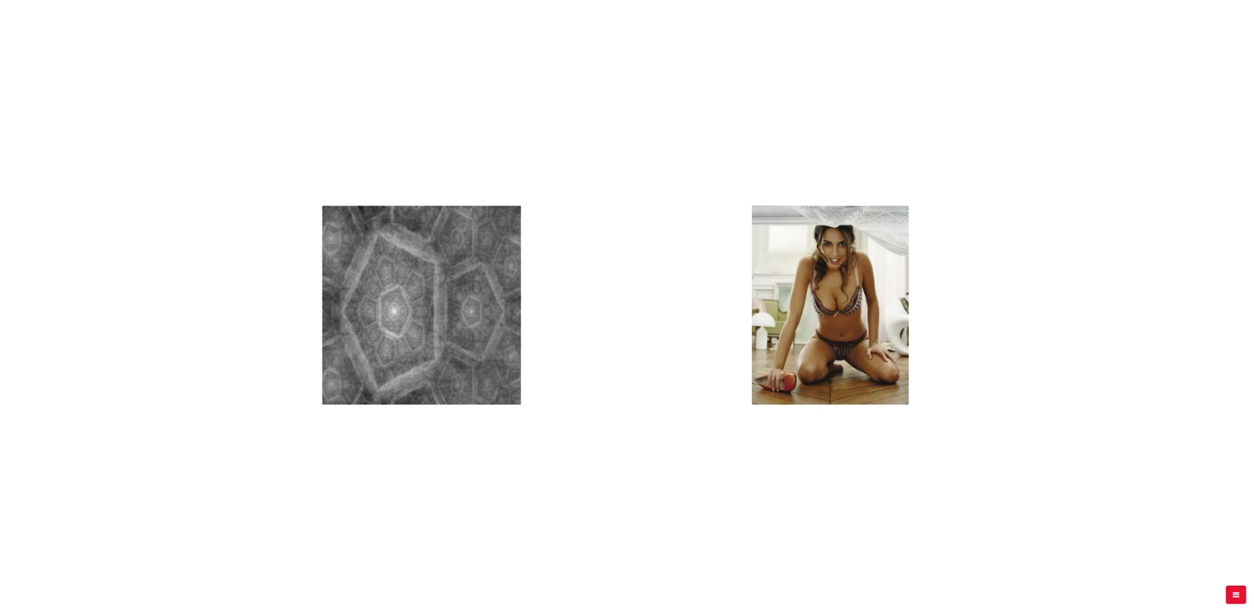

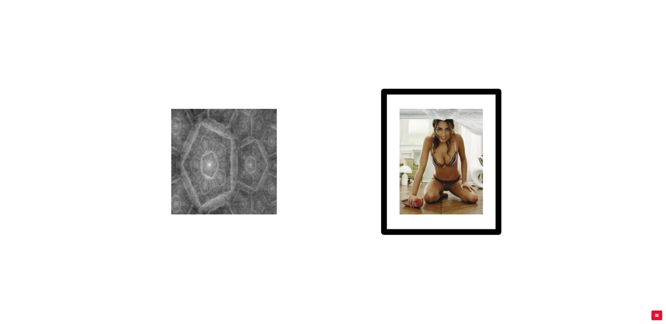
Viewing Task
Fixation
Unif(1,5) s
Information
1 s
Wait
{1,2,3,4} s
Outcome
2 s
Feedback
(part of the 2 s)

Slide 22

Viewing Task
Heterosexual male subjects
Crockett et al. (2013), Sescouse et al. (2013), and informal confirmation from Kiyo that heterosexual male vmPFC lights up upon presentation of these types of stimuli.
Fixation
Unif(1,5) s
Information
1 s
Wait
{1,2,3,4} s
Stimuli from Crockett et al. (2013).
Also used in Iigaya et al. (2016) and Iigaya (2020).
We select the top 72 images based on ratings from Crocket et al. (2013).
Outcome
2 s
Feedback
(part of the 2 s)

Slide 23
Viewing Task
Fixation
Unif(1,5) s
Information
1 s
Wait
{1,2,3,4} s
Outcome
2 s
Feedback
(part of the 2 s)

Slide 24
Viewing Task Conditions
Probability (P) |  | 1 | 2/3 | 1/3 | 0
Block H E[P]=2/3 | Proportion | 1/3 | 1/3 | 1/3 | -
 | Reward | 24 | 16 | 8 | -
 | No Reward | - | 8 | 16 | -
Block L E[P]=1/3 | Proportion | - | 1/3 | 1/3 | 1/3
 | Reward | - | 16 | 8 | -
 | No Reward | - | 8 | 16 | 24

Slide 25
Why these conditions?
Probability (P) |  | 1 | 2/3 | 1/3 | 0
Block H | Proportion | 1/3 | 1/3 | 1/3 | -
Block L | Proportion | - | 1/3 | 1/3 | 1/3
Context | H |  |  | L
Probability | 1 | 2/3 | 1/3 | 2/3 | 1/3 | 0
EU = cEU | 0 | 0 | 0 | 0 | 0 | 0
EU = cEU + sEU | 1/3 | 0 | -1/3 | 1/3 | 0 | -1/3
@ info screen
Outcome | Reward |  |  | No Reward
Probability | 1 | 2/3 | 1/3 | 2/3 | 1/3 | 0
EU = cEU | 1 | 1 | 1 | 0 | 0 | 0
EU = cEU + sEU | 1 | 1 1/3 | 1 2/3 | -2/3 | -1/3 | 0
@ outcome screen

Slide 26
F(Reward, P=1)
Probability (P) |  | 1 | 2/3 | 1/3 | 0
Block H E[P]=2/3 | Proportion | 1/3 | 1/3 | 1/3 | -
 | Reward | 24 | 16 | 8 | -
 | No Reward | - | 8 | 16 | -
Block L E[P]=1/3 | Proportion | - | 1/3 | 1/3 | 1/3
 | Reward | - | 16 | 8 | -
 | No Reward | - | 8 | 16 | 24
Context | H |  |  | L
Probability | 1 | 2/3 | 1/3 | 2/3 | 1/3 | 0
EU = cEU | 0 | 0 | 0 | 0 | 0 | 0
EU = cEU + sEU | 1/3 | 0 | -1/3 | 1/3 | 0 | -1/3
@ info screen
Outcome | Reward |  |  | No Reward
Probability | 1 | 2/3 | 1/3 | 2/3 | 1/3 | 0
EU = cEU | 1 | 1 | 1 | 0 | 0 | 0
EU = cEU + sEU | 1 | 1 1/3 | 1 2/3 | -2/3 | -1/3 | 0
@ outcome screen

Slide 27
F(No Reward, P=0)
Probability (P) |  | 1 | 2/3 | 1/3 | 0
Block H E[P]=2/3 | Proportion | 1/3 | 1/3 | 1/3 | -
 | Reward | 24 | 16 | 8 | -
 | No Reward | - | 8 | 16 | -
Block L E[P]=1/3 | Proportion | - | 1/3 | 1/3 | 1/3
 | Reward | - | 16 | 8 | -
 | No Reward | - | 8 | 16 | 24
Context | H |  |  | L
Probability | 1 | 2/3 | 1/3 | 2/3 | 1/3 | 0
EU = cEU | 0 | 0 | 0 | 0 | 0 | 0
EU = cEU + sEU | 1/3 | 0 | -1/3 | 1/3 | 0 | -1/3
@ info screen
Outcome | Reward |  |  | No Reward
Probability | 1 | 2/3 | 1/3 | 2/3 | 1/3 | 0
EU = cEU | 1 | 1 | 1 | 0 | 0 | 0
EU = cEU + sEU | 1 | 1 1/3 | 1 2/3 | -2/3 | -1/3 | 0
@ outcome screen

Slide 28
F(Reward, P=1/3)
Probability (P) |  | 1 | 2/3 | 1/3 | 0
Block H E[P]=2/3 | Proportion | 1/3 | 1/3 | 1/3 | -
 | Reward | 24 | 16 | 8 | -
 | No Reward | - | 8 | 16 | -
Block L E[P]=1/3 | Proportion | - | 1/3 | 1/3 | 1/3
 | Reward | - | 16 | 8 | -
 | No Reward | - | 8 | 16 | 24
Context | H |  |  | L
Probability | 1 | 2/3 | 1/3 | 2/3 | 1/3 | 0
EU = cEU | 0 | 0 | 0 | 0 | 0 | 0
EU = cEU + sEU | 1/3 | 0 | -1/3 | 1/3 | 0 | -1/3
@ info screen
Outcome | Reward |  |  | No Reward
Probability | 1 | 2/3 | 1/3 | 2/3 | 1/3 | 0
EU = cEU | 1 | 1 | 1 | 0 | 0 | 0
EU = cEU + sEU | 1 | 1 1/3 | 1 2/3 | -2/3 | -1/3 | 0
@ outcome screen

Slide 29
F(No Reward, P=1/3)
Probability (P) |  | 1 | 2/3 | 1/3 | 0
Block H E[P]=2/3 | Proportion | 1/3 | 1/3 | 1/3 | -
 | Reward | 24 | 16 | 8 | -
 | No Reward | - | 8 | 16 | -
Block L E[P]=1/3 | Proportion | - | 1/3 | 1/3 | 1/3
 | Reward | - | 16 | 8 | -
 | No Reward | - | 8 | 16 | 24
Context | H |  |  | L
Probability | 1 | 2/3 | 1/3 | 2/3 | 1/3 | 0
EU = cEU | 0 | 0 | 0 | 0 | 0 | 0
EU = cEU + sEU | 1/3 | 0 | -1/3 | 1/3 | 0 | -1/3
@ info screen
Outcome | Reward |  |  | No Reward
Probability | 1 | 2/3 | 1/3 | 2/3 | 1/3 | 0
EU = cEU | 1 | 1 | 1 | 0 | 0 | 0
EU = cEU + sEU | 1 | 1 1/3 | 1 2/3 | -2/3 | -1/3 | 0
@ outcome screen

Slide 30
F(H, P=1)
Probability (P) |  | 1 | 2/3 | 1/3 | 0
Block H E[P]=2/3 | Proportion | 1/3 | 1/3 | 1/3 | -
 | Reward | 24 | 16 | 8 | -
 | No Reward | - | 8 | 16 | -
Block L E[P]=1/3 | Proportion | - | 1/3 | 1/3 | 1/3
 | Reward | - | 16 | 8 | -
 | No Reward | - | 8 | 16 | 24
Context | H |  |  | L
Probability | 1 | 2/3 | 1/3 | 2/3 | 1/3 | 0
EU = cEU | 0 | 0 | 0 | 0 | 0 | 0
EU = cEU + sEU | 1/3 | 0 | -1/3 | 1/3 | 0 | -1/3
@ info screen
Outcome | Reward |  |  | No Reward
Probability | 1 | 2/3 | 1/3 | 2/3 | 1/3 | 0
EU = cEU | 1 | 1 | 1 | 0 | 0 | 0
EU = cEU + sEU | 1 | 1 1/3 | 1 2/3 | -2/3 | -1/3 | 0
@ outcome screen

Slide 31
F(H, P=1/3)
Probability (P) |  | 1 | 2/3 | 1/3 | 0
Block H E[P]=2/3 | Proportion | 1/3 | 1/3 | 1/3 | -
 | Reward | 24 | 16 | 8 | -
 | No Reward | - | 8 | 16 | -
Block L E[P]=1/3 | Proportion | - | 1/3 | 1/3 | 1/3
 | Reward | - | 16 | 8 | -
 | No Reward | - | 8 | 16 | 24
Context | H |  |  | L
Probability | 1 | 2/3 | 1/3 | 2/3 | 1/3 | 0
EU = cEU | 0 | 0 | 0 | 0 | 0 | 0
EU = cEU + sEU | 1/3 | 0 | -1/3 | 1/3 | 0 | -1/3
@ info screen
Outcome | Reward |  |  | No Reward
Probability | 1 | 2/3 | 1/3 | 2/3 | 1/3 | 0
EU = cEU | 1 | 1 | 1 | 0 | 0 | 0
EU = cEU + sEU | 1 | 1 1/3 | 1 2/3 | -2/3 | -1/3 | 0
@ outcome screen

Slide 32
F(L, P=1/3)
Probability (P) |  | 1 | 2/3 | 1/3 | 0
Block H E[P]=2/3 | Proportion | 1/3 | 1/3 | 1/3 | -
 | Reward | 24 | 16 | 8 | -
 | No Reward | - | 8 | 16 | -
Block L E[P]=1/3 | Proportion | - | 1/3 | 1/3 | 1/3
 | Reward | - | 16 | 8 | -
 | No Reward | - | 8 | 16 | 24
Context | H |  |  | L
Probability | 1 | 2/3 | 1/3 | 2/3 | 1/3 | 0
EU = cEU | 0 | 0 | 0 | 0 | 0 | 0
EU = cEU + sEU | 1/3 | 0 | -1/3 | 1/3 | 0 | -1/3
@ info screen
Outcome | Reward |  |  | No Reward
Probability | 1 | 2/3 | 1/3 | 2/3 | 1/3 | 0
EU = cEU | 1 | 1 | 1 | 0 | 0 | 0
EU = cEU + sEU | 1 | 1 1/3 | 1 2/3 | -2/3 | -1/3 | 0
@ outcome screen

Slide 33
Model Predictions
Context | H |  |  | L
Probability | 1 | 2/3 | 1/3 | 2/3 | 1/3 | 0
EU = cEU | 0 | 0 | 0 | 0 | 0 | 0
EU = cEU + sEU | 1/3 | 0 | -1/3 | 1/3 | 0 | -1/3
Outcome | Reward |  |  | No Reward
Probability | 1 | 2/3 | 1/3 | 2/3 | 1/3 | 0
EU = cEU | 1 | 1 | 1 | 0 | 0 | 0
EU = cEU + sEU | 1 | 1 1/3 | 1 2/3 | -2/3 | -1/3 | 0
1 | F(Reward, P=1/3) | > | F(Reward, P=1)
2 | F(No Reward, P=0) | > | F(No Reward, P=1/3)
3 | F(H, P=1) | > | F(H, P=1/3)
4 | F(L, P=1/3) | > | F(H, P=1/3)
5 | F(L, P=1/3) | = | F(No Reward, P=0)
6 | F(H, P=1/3) | = | F(No Reward, P=1/3)

Slide 34
Model Predictions
Context | H |  |  | L
Probability | 1 | 2/3 | 1/3 | 2/3 | 1/3 | 0
EU = cEU | 0 | 0 | 0 | 0 | 0 | 0
EU = cEU + sEU | 1/3 | 0 | -1/3 | 1/3 | 0 | -1/3
Outcome | Reward |  |  | No Reward
Probability | 1 | 2/3 | 1/3 | 2/3 | 1/3 | 0
EU = cEU | 1 | 1 | 1 | 0 | 0 | 0
EU = cEU + sEU | 1 | 1 1/3 | 1 2/3 | -2/3 | -1/3 | 0
1 | F(Reward, P=1/3) | > | F(Reward, P=1)
2 | F(No Reward, P=0) | > | F(No Reward, P=1/3)
3 | F(H, P=1) | > | F(H, P=1/3)
4 | F(L, P=1/3) | > | F(H, P=1/3)
5 | F(L, P=1/3) | = | F(No Reward, P=0)
6 | F(H, P=1/3) | = | F(No Reward, P=1/3)

Slide 35
Model Predictions
Context | H |  |  | L
Probability | 1 | 2/3 | 1/3 | 2/3 | 1/3 | 0
EU = cEU | 0 | 0 | 0 | 0 | 0 | 0
EU = cEU + sEU | 1/3 | 0 | -1/3 | 1/3 | 0 | -1/3
Outcome | Reward |  |  | No Reward
Probability | 1 | 2/3 | 1/3 | 2/3 | 1/3 | 0
EU = cEU | 1 | 1 | 1 | 0 | 0 | 0
EU = cEU + sEU | 1 | 1 1/3 | 1 2/3 | -2/3 | -1/3 | 0
1 | F(Reward, P=1/3) | > | F(Reward, P=1)
2 | F(No Reward, P=0) | > | F(No Reward, P=1/3)
3 | F(H, P=1) | > | F(H, P=1/3)
4 | F(L, P=1/3) | > | F(H, P=1/3)
5 | F(L, P=1/3) | = | F(No Reward, P=0)
6 | F(H, P=1/3) | = | F(No Reward, P=1/3)

Slide 36
Model Predictions
Context | H |  |  | L
Probability | 1 | 2/3 | 1/3 | 2/3 | 1/3 | 0
EU = cEU | 0 | 0 | 0 | 0 | 0 | 0
EU = cEU + sEU | 1/3 | 0 | -1/3 | 1/3 | 0 | -1/3
Outcome | Reward |  |  | No Reward
Probability | 1 | 2/3 | 1/3 | 2/3 | 1/3 | 0
EU = cEU | 1 | 1 | 1 | 0 | 0 | 0
EU = cEU + sEU | 1 | 1 1/3 | 1 2/3 | -2/3 | -1/3 | 0
1 | F(Reward, P=1/3) | > | F(Reward, P=1)
2 | F(No Reward, P=0) | > | F(No Reward, P=1/3)
3 | F(H, P=1) | > | F(H, P=1/3)
4 | F(L, P=1/3) | > | F(H, P=1/3)
5 | F(L, P=1/3) | = | F(No Reward, P=0)
6 | F(H, P=1/3) | = | F(No Reward, P=1/3)

Slide 37
Model Predictions
Context | H |  |  | L
Probability | 1 | 2/3 | 1/3 | 2/3 | 1/3 | 0
EU = cEU | 0 | 0 | 0 | 0 | 0 | 0
EU = cEU + sEU | 1/3 | 0 | -1/3 | 1/3 | 0 | -1/3
Outcome | Reward |  |  | No Reward
Probability | 1 | 2/3 | 1/3 | 2/3 | 1/3 | 0
EU = cEU | 1 | 1 | 1 | 0 | 0 | 0
EU = cEU + sEU | 1 | 1 1/3 | 1 2/3 | -2/3 | -1/3 | 0
1 | F(Reward, P=1/3) | > | F(Reward, P=1)
2 | F(No Reward, P=0) | > | F(No Reward, P=1/3)
3 | F(H, P=1) | > | F(H, P=1/3)
4 | F(L, P=1/3) | > | F(H, P=1/3)
5 | F(L, P=1/3) | = | F(No Reward, P=0)
6 | F(H, P=1/3) | = | F(No Reward, P=1/3)

Slide 38
Model Predictions
Context | H |  |  | L
Probability | 1 | 2/3 | 1/3 | 2/3 | 1/3 | 0
EU = cEU | 0 | 0 | 0 | 0 | 0 | 0
EU = cEU + sEU | 1/3 | 0 | -1/3 | 1/3 | 0 | -1/3
Outcome | Reward |  |  | No Reward
Probability | 1 | 2/3 | 1/3 | 2/3 | 1/3 | 0
EU = cEU | 1 | 1 | 1 | 0 | 0 | 0
EU = cEU + sEU | 1 | 1 1/3 | 1 2/3 | -2/3 | -1/3 | 0
1 | F(Reward, P=1/3) | > | F(Reward, P=1)
2 | F(No Reward, P=0) | > | F(No Reward, P=1/3)
3 | F(H, P=1) | > | F(H, P=1/3)
4 | F(L, P=1/3) | > | F(H, P=1/3)
5 | F(L, P=1/3) | = | F(No Reward, P=0)
6 | F(H, P=1/3) | = | F(No Reward, P=1/3)

Slide 39
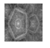
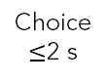
Fractal Choice Task
Fixation
1 s
Choice
$≤$2 s
Wait
{1,2,3,4} s
Outcome
2 s

Slide 40

Fractal Choice Task
Fixation
1 s
Choice
$≤$2 s
Wait
{1,2,3,4} s
Outcome
2 s
Test each of the 6 predictions 4 times = 24 trials

Slide 41
Rating Task
Fixation
1 s
Discrete ratings
-1
Dislike
0
Neutral
5
Really Like
Rating
Free RT

Slide 42
If you can test for sEU using the (behavioral) fractal choice task, why bother collecting fMRI data?

Slide 43
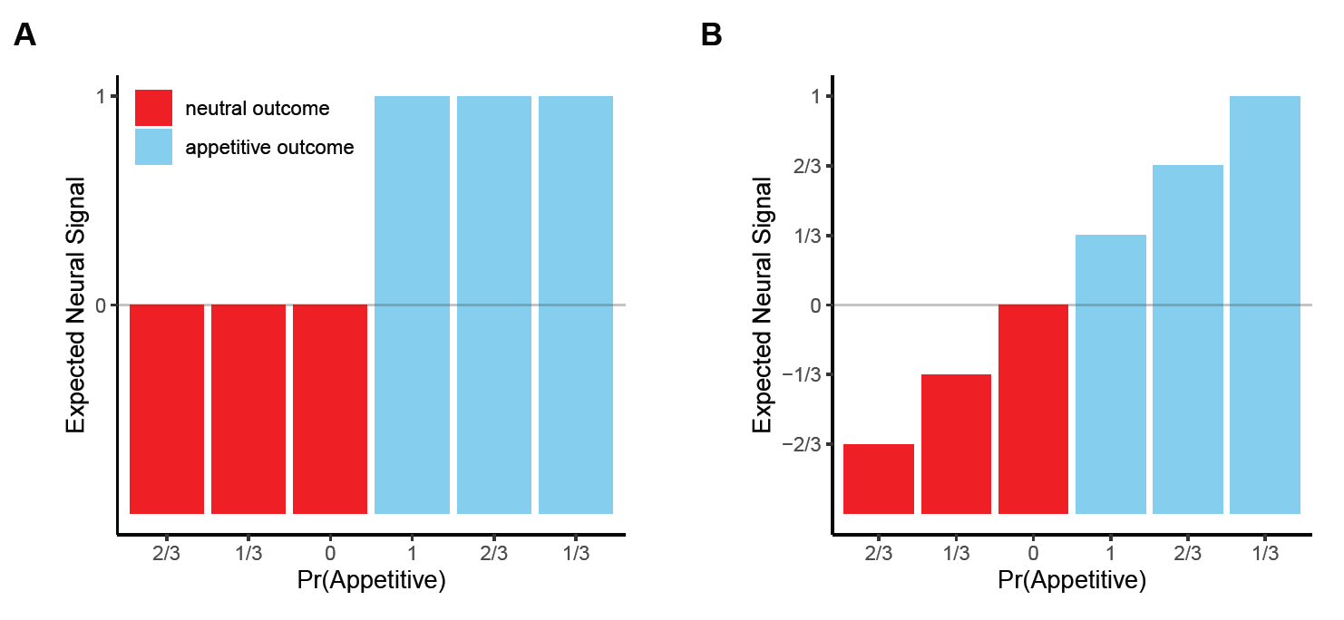
1. to show that value signals in OFC incorporate sEU

Slide 44
2. to differentiate sEU from anticipation utility
Fixation
Unif(1,5) s
Information
1 s
Wait
{1,2,3,4} s
sEU
no sEU
Outcome
2 s
sEU
Feedback
(part of the 2 s)

Slide 45
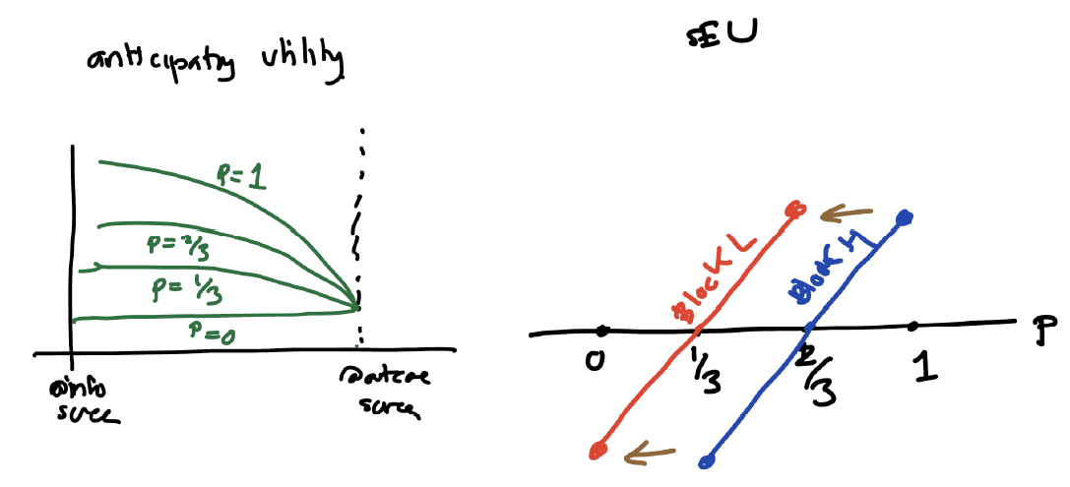
Anticipation Utility (aEU)
Iigaya et al. (2016, 2020)
aEU only depends on the probability of getting reward, not the context.
It is also decreasing in proximity to reward (e.g. distance or time), unlike sEU which is a transient experience at the time of information acquisition.
Context | H |  |  | L
Probability | 1 | 2/3 | 1/3 | 2/3 | 1/3 | 0
EU = cEU | 0 | 0 | 0 | 0 | 0 | 0
EU = cEU + sEU | 1/3 | 0 | -1/3 | 1/3 | 0 | -1/3
EU = cEU + aEU | 1 | 2/3 | 1/3 | 2/3 | 1/3 | 0
@ info screen
AR Notes

Slide 46
Anticipation Utility (aEU)
Iigaya et al. (2016, 2020)
aEU only depends on the probability of getting reward, not the context.
It is also decreasing in proximity to reward (e.g. distance or time), unlike sEU which is a transient experience at the time of information acquisition.
Context | H |  |  | L
Probability | 1 | 2/3 | 1/3 | 2/3 | 1/3 | 0
EU = cEU | 0 | 0 | 0 | 0 | 0 | 0
EU = cEU + sEU | 1/3 | 0 | -1/3 | 1/3 | 0 | -1/3
EU = cEU + aEU | 1 | 2/3 | 1/3 | 2/3 | 1/3 | 0
@ info screen
AR Notes

Slide 47
Anticipation Utility (aEU)
Iigaya et al. (2016, 2020)
aEU only depends on the probability of getting reward, not the context.
It is also decreasing in proximity to reward (e.g. distance or time), unlike sEU which is a transient experience at the time of information acquisition.
Context | H |  |  | L
Probability | 1 | 2/3 | 1/3 | 2/3 | 1/3 | 0
EU = cEU | 0 | 0 | 0 | 0 | 0 | 0
EU = cEU + sEU | 1/3 | 0 | -1/3 | 1/3 | 0 | -1/3
EU = cEU + aEU | 1 | 2/3 | 1/3 | 2/3 | 1/3 | 0
@ info screen
AR Notes

Slide 48
